Slide 1
SUMMER CAMP
MEP – LENOIR COUNTY

Slide 2
MEP – LENOIR COUNTY
SUMMER CAMP
Description:
The purpose of this summer program is to get students engaged in a variety of activities that will enhance their creative thinking skills. Different types of presenters will be invited to motivate students to continue their education and pursue different career paths.
Vision:
To see our migrant students reach their full potential by overcoming social, economic, and cultural barriers to continue their education.
Mission:
Develop a summer program that will motivate and educate migrant students through critical and creative thinking activities.

Slide 4
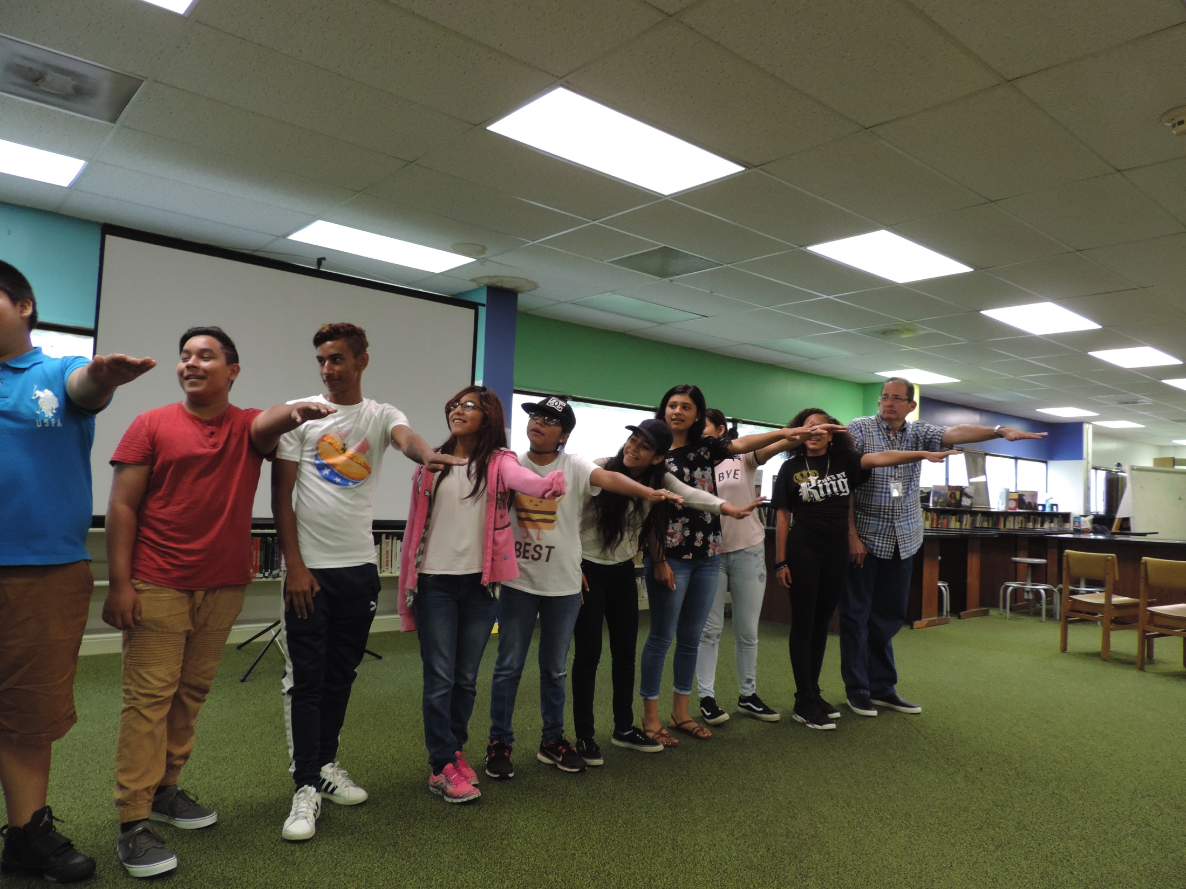
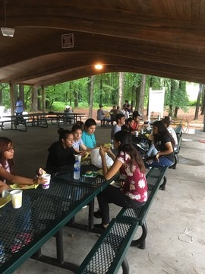
MEP – LENOIR COUNTY
SUMMER CAMP
Objective:
To provide a summer program with fun educational enrichment activities: That will emphasize the social, emotional and intellectual development of our migrant students.
Program Collaboration:
Within the program we will teach unique skills and expose our youth to new experiences.
Example:
Academic Presentations
Creative Thinking Activities
Professional Speakers
Targeted Students:
Middle and High School Students

Slide 5
MEP – LENOIR COUNTY
SUMMER CAMP
STEPS:
Beginning Planning :
Start on April
Met every week
2) Determinate the dates :
Choose Places:
Available Parks.
School Building.
Three Days:
First Day: At the park ( make fun ) small present for student participation and Music.
Second Day: Academic, Guest Speaker.
Third Day: Field Trip.

Slide 6
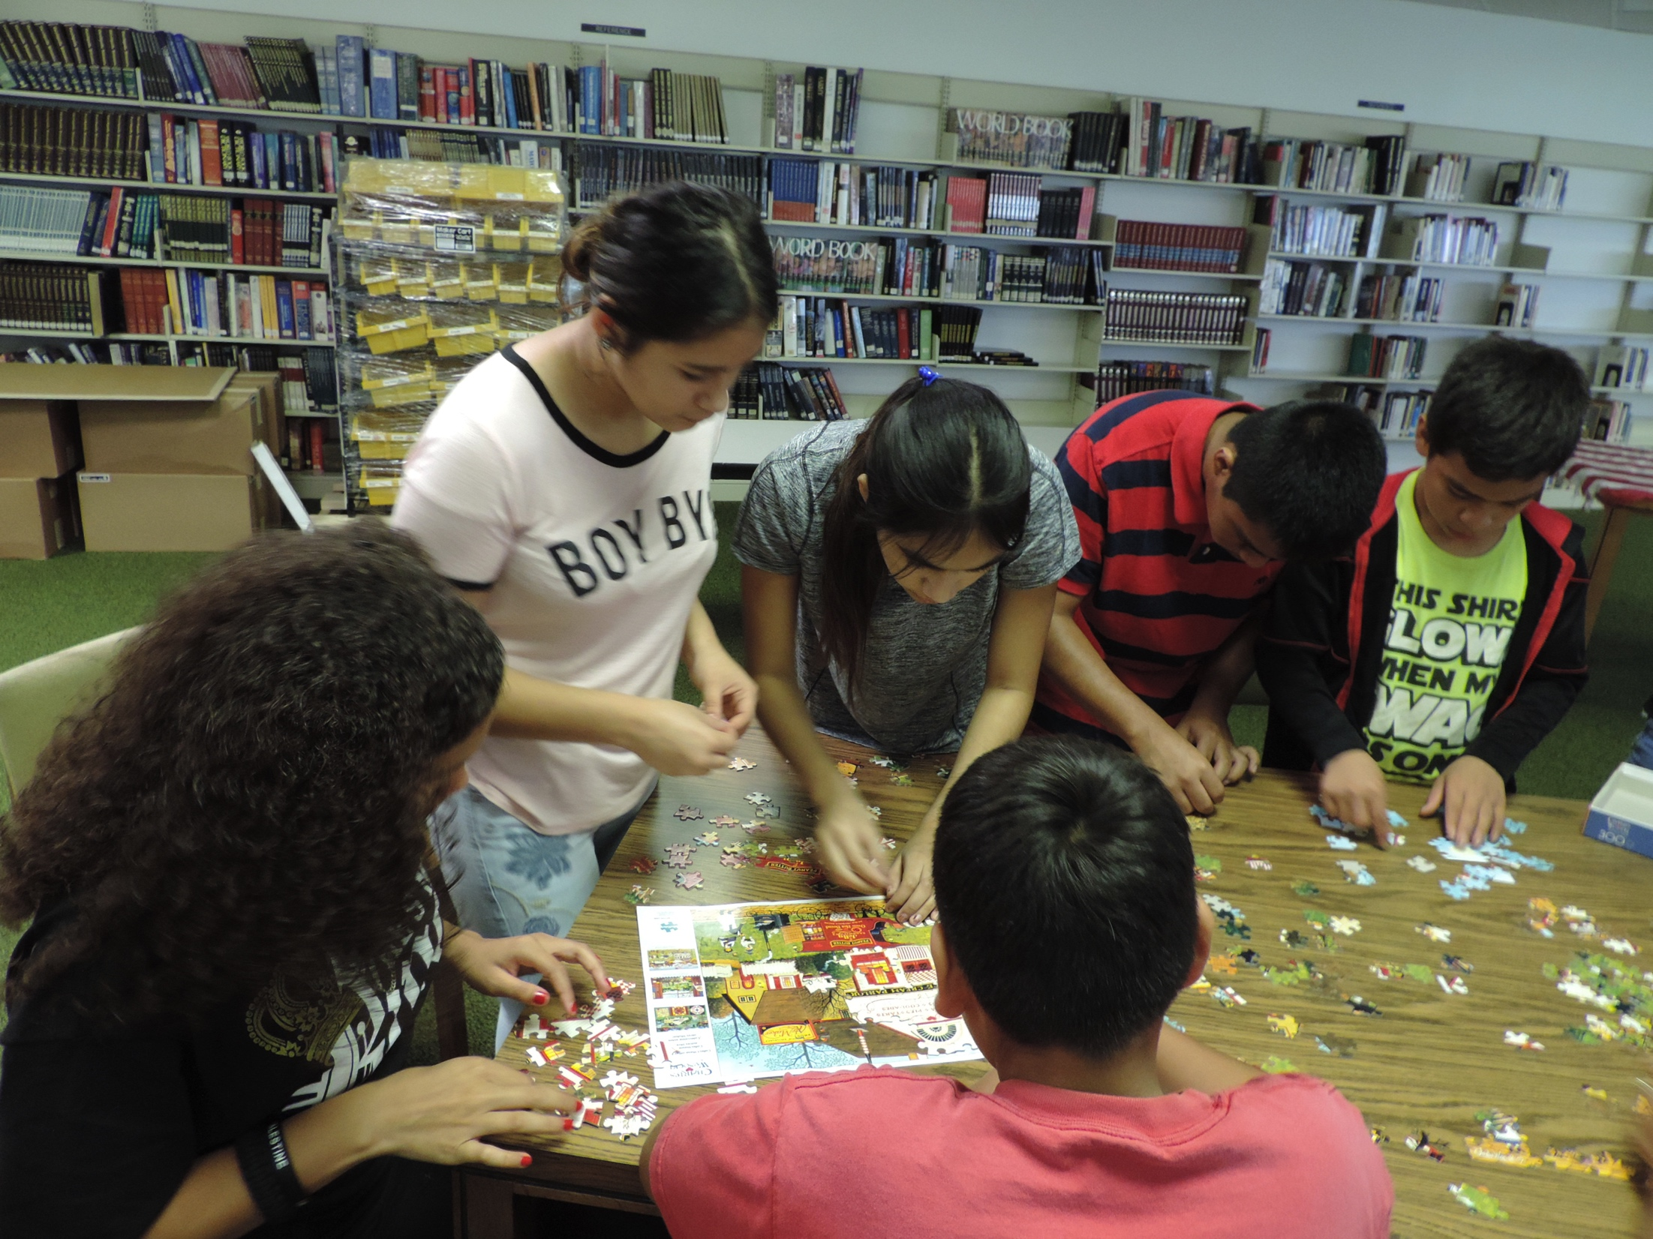
MEP – LENOIR COUNTY
SUMMER CAMP
3) Choose The Theme:
Using School Assessment.
4) Determinate the dates :
Choose Places:
Available Parks.
School Building.
Transportation.
Three Days:
First Day: At the park ( make fun ) small present for student participation and Music.
Second Day: Academic, Guest Speaker.
Third Day: Field Trip.

Slide 7
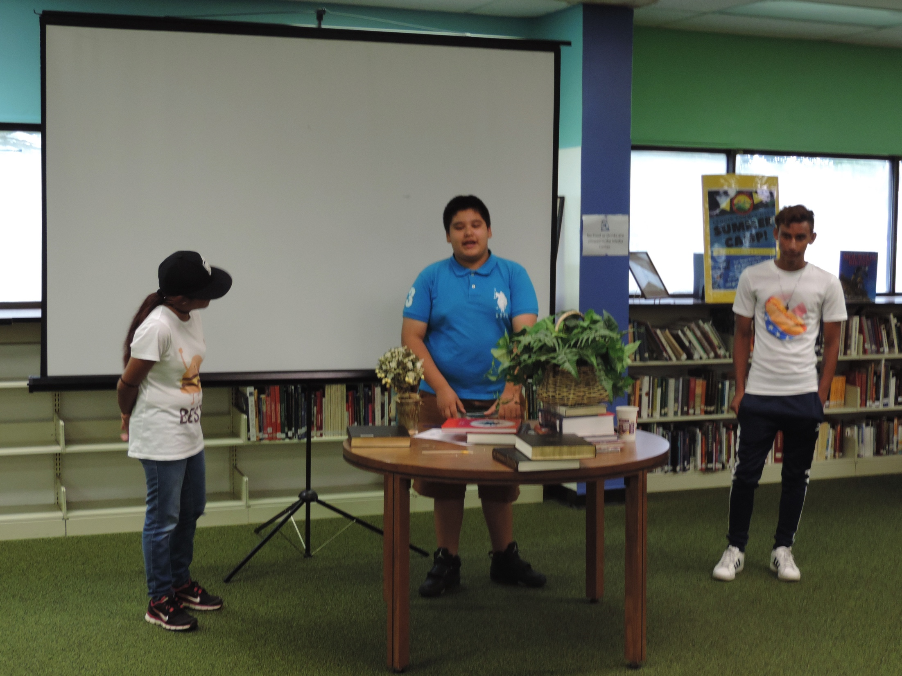
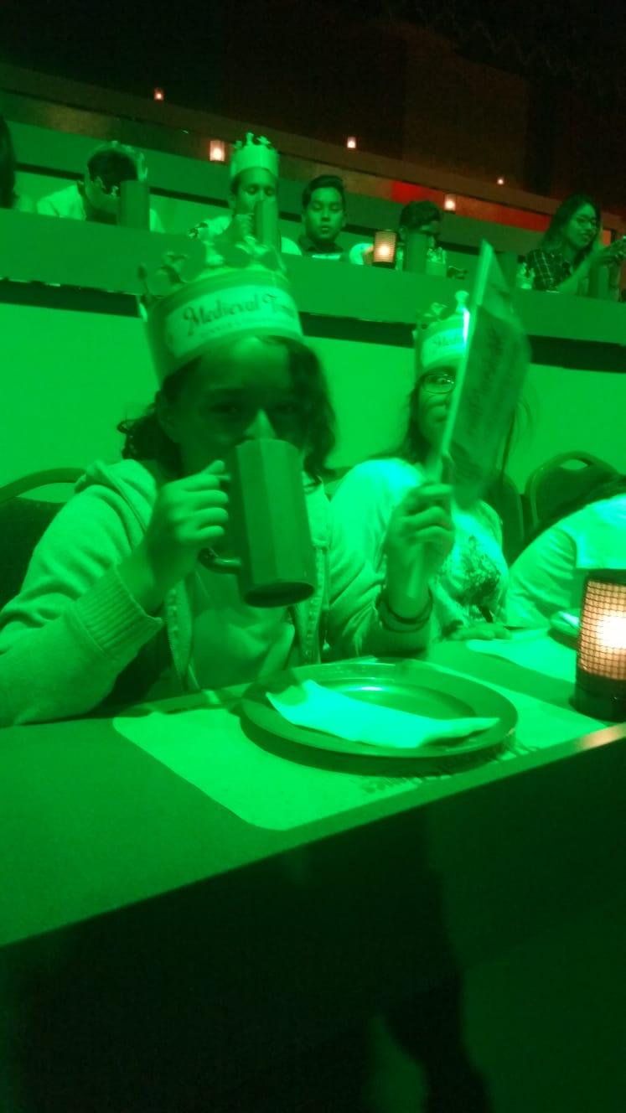
MEP – LENOIR COUNTY
SUMMER CAMP
4) Activity Planning:
Every recruiter brings ideas, videos and games.
5) Convince the Kids :
Make a pretty Poster.
Visit one by one.
Request a travel permit for students.
6) Meals Planning :
Request Donation.
MEP funds.

