Slide 1
Migrant Student Information Exchange (MSIX): A Tool for School Staff
NC DPI- Migrant Education Program
Division of Federal Program Monitoring and Support
Updated May 2020

Slide 2
Objectives
Understand the purpose of the Migrant Student Information Exchange (MSIX)
Understand how MSIX can be used by both MEP and school staff in a variety of roles
Review the importance of protecting student information
Apply this understanding to real-life scenarios
Understand the regulations for MSIX

Slide 3
Legal References
Statute
Sections 1304(b)(3) and 1308(b) of the Elementary and Secondary Education Act (ESEA) of 1965, as amended by Every Student Succeeds Act (ESSA) of 2015
Code of Federal Regulations
34 CFR 200.81, 200.82(c) and 200.85
Guidance
Non-Regulatory Guidance for Title I, Part C, Education of Migratory Children: Chapter VI, D (2010)

Slide 4
What is MSIX?
It is a collaborative effort to help the Department of Education (ED) and states:
Establish standards for the minimum education and health data that each state must collect and maintain in its electronic state migrant student record system
Develop an electronic exchange to link all states' migrant student record systems, facilitating the consolidation of migrant students’ education and health information
Create a Web-based, consolidated, migrant student record that can be used by authorized school personnel to facilitate school enrollment, grade, and course placement, and the accrual of secondary school course credits
Produce useable information on the migrant children population
Notes:
Provide a standard across states on the information that we must all keep on migrant students across the U.S.
Allow for states to share information on students and consolidate the information as they move from state to state
Create a consolidated record for migrant students
Provides nationwide information on the migrant student population

Slide 5
Why MSIX?
Why do you think it might be helpful to have a nationwide information system for migrant students?
Notes:
Allow participants time to answer

Slide 6
Why MSIX?
Migrant children often enroll in multiple schools for varying lengths of time
High mobility has created barriers to timely transfer of records

Slide 7
Why MSIX?
What happens when student records aren’t transferred in a timely manner?
Delayed enrollment
Inappropriate grade placement
Inappropriate course placement for secondary students
Notes:
Allow participants time to answer before showing hash marks

Slide 8
How does MSIX receive NC Migrant Student Data?
Each time we complete a Certificate of Eligibility (COE) it is input into PowerSchool
PowerSchool submits a nightly upload of migrant student data to a secure server that then passes the data to MSIX
Notes:
So now that we understand why MSIX is helpful let’s briefly talk about how it receives information – for school staff, explain the COE process briefly (how students are enrolled in the MEP)

Slide 9
Student Privacy and MSIX
MSIX only collects the data elements required to match student records
Only authorized staff can access this information
The system was developed in accordance with federal requirements to safeguard the privacy and security of education data
Notes:
Before we go any further and actually look at the system, it is required that we talk about how MSIX protects student’s information

Slide 10
Let’s take a poll!
Should you send students’ names in e-mails?
Should you send UIDs in e-mails?
Now let’s watch a brief video on keep student info secure: https://studentprivacy.ed.gov/training/email-and-student-privacy
Notes:
You should not send student’s names in an e-mail
It is acceptable to send PS IDs, UIDs and/or MSIX IDs to identify children
** Show Dept of Ed Video on Student Privacy** - this is a requirement of all users of MSIX to watch this video

Slide 11
Passwords
are
case
sensitive
Notes:
This is a video… click again to start the video

Slide 12
User Toolbar
Notes:
This is what will show up after you search for a student. This is the Consolidated View Screen. I have the other options for “view” circled in red. We will look at what historical view also looks like in a later slide. The student’s name is blacked out for privacy, but this is what you will initially see at the top: Student name, MSIX ID, state ID, and gender. In the red box, these are your user tools: (talk about each one briefly) data request, flag for merge, move notice, and export. – describe each one briefly

Slide 13
Student Overview: Consolidated View
Notes:
This is what else in in the top part of the consolidated view screen: explain the info that is shown– this is what is typically collected on the MEP COE

Slide 14
Enrollments
Notes:
Underneath the general student info is the enrollments screen. This shows all of the school enrollments where the student has also been enrolled in an MEP. You will be able to see other states’ enrollments as well. However, the only enrollments that will show up are those where the student was also enrolled in the MEP. So, if a student goes to a state and doesn’t get recruited into the MEP, the record for that state will not show up in MSIX

Slide 15
Assessment Data
Notes:
Below the enrollment screen is the assessment data. This includes data on all state tests.

Slide 16
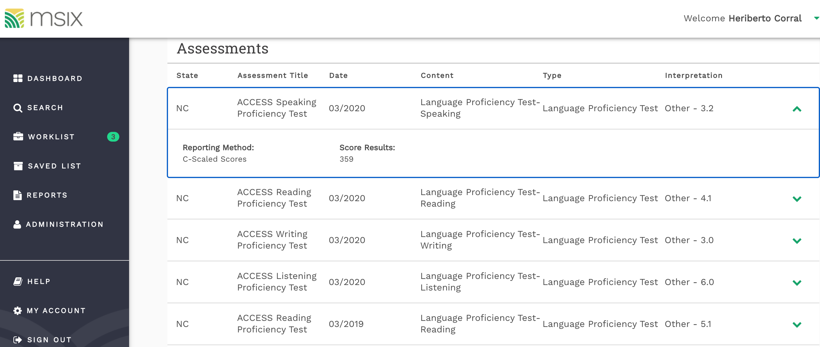
Detailed Information: Assessment Data
Notes:
This is the detailed view of the assessment data. If you click the down arrow, the assessment will expand to allow you to see more detailed information.

Slide 17
Course History
Notes:
Finally, you will see course history at the bottom of the consolidated view screen. This will include the grades and courses for all secondary (high school) courses completed.

Slide 18
Historical View: Non-Detailed
Notes:
This is the historical view. If a student has enrollments in multiple states, you will see the names of each of those states listed here with the student’s state ID in parentheses beside the state name.

Slide 19
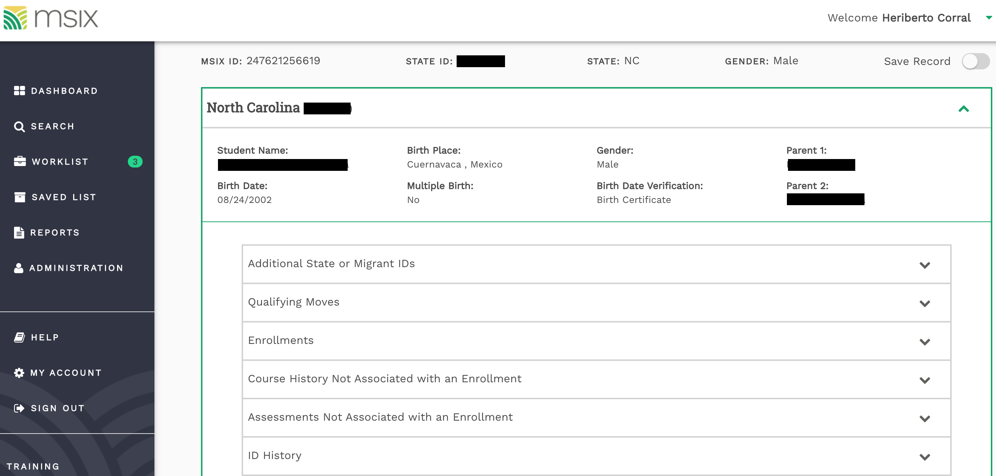
Historical View: Detailed
Notes:
You can expand each state by clicking the down arrow, and it will provide you with more information specific to that state. For example, I will be able to see all of the moves that a student made within NC using the historical detailed view.
**You may want to pause and show the audience your MSIX account if you are training staff within only your district** You can look up a student in your district so that staff can see how the screens look with the student name and how they can look at special circumstance markers like PFS, LEP, and IEP

Slide 20
MSIX Users

Slide 21
Who can use MSIX?
MEP Staff (Recruiters, Liaisons, Advocates, Service Providers)
Counselors
Data Managers / Registrars
Notes:
We will talk about how each of these roles can utilize MSIX to their benefit

Slide 22
Using MSIX as a Recruiter
Send move notifications
Review past move information
Review family contact information

Slide 23
Using MSIX as a Counselor/Data Specialist
Send a move notification
View special needs/circumstances markers
Obtain correct student demographic information
View student’s enrollment and course history
View student’s assessment history

Slide 24
Using MSIX as a Liaison/Migrant Advocate
Send move notifications
Research student record to determine any special needs
View student enrollment and assessment history to ensure appropriate grade and course placement
Use data to plan for MEP-specific services

Slide 25
Applying MSIX Use to Scenarios
You are a MEP parent liaison in the district. Your State Data Administrator sends you a move notification in MSIX to notify you that Luisa Valdez will be moving into your district. Before she arrives, you log onto MSIX and see that Luisa has an IEP in the district that she is moving from.
What are some next steps you could take thanks to obtaining this information from MSIX?

Slide 26
Applying MSIX Use to Scenarios
You are a guidance counselor at the local high school. Mona, a 19-year-old, just enrolled in your high school, her third school this year. She tells you that she hopes to graduate from high school in a few months but neither her nor her parents have copies of her earlier transcripts.
What are some ways that you could utilize MSIX in order to better service this student?
Notes:
View course history
Request official records

Slide 27
Applying MSIX Use to Scenarios
You are a recruiter at a local school district. You are interviewing a family who recently moved into your district. They tell you that they came from Florida where they were working in the strawberry harvest. However, they can not remember the name of town where they were living in Florida.
What are some ways that you could utilize MSIX in order to better service this student?
Notes:
Look to see if they were enrolled in a migrant program in Florida
Send information to state data administrator in florida to obtain more information on the student

Slide 28
Discussion: What are some other scenarios where MSIX might be helpful?

Slide 29
How can you get access to MSIX?
Complete the application located in the NC MSIX Policy Manual at http://www.ncpublicschools.org/docs/mep/resources/data/msix/msix-manual.pdf
Sign, scan, and email application to the State Data Administrator

Slide 30
Accessing MSIX
After you complete your application, you must have a verifying authority sign off on it (your supervisor), scan, and email it to me at Heriberto.corral@dpi.nc.gov
For Password Resets – Follow new protocol “Security Questions” if blocked then contact NC MEP Administrator at Heriberto.corral@dpi.nc.gov

Slide 31
Part II- MSIX Regulations
Regulations that are applicable to MEP staff regarding the use of MSIX

Slide 32
Requirements of LEAs
Have at least 5-10 non-MEP secondary staff with access to MSIX
Intrastate and Interstate Move Notifications
Respond to Data Requests
Notes:
So the first requirement is why you all are here. It is a requirement that non-MEP school staff are trained and are utilizing MSIX. The other two requirements are directly related and are typically the responsibility of the Migrant Program. However, school staff may also make data requests.

Slide 33
Data Request
These can be a great tool when you haven’t received information that you need on a student
States must respond to these requests

Slide 34
Data Request
States must respond to data requests within 10 working days
It is acceptable to send a data request when you notice errors or missing information on a student
34 CFR 200.85 (e)
Notes:
Demonstrate how to send a data request if you have not already.

Slide 35
Next Steps…
Submit application for access to MSIX to your Federal Programs, Title I, or MEP Director
Watch refresher training videos within MSIX once you receive acces
Use MSIX to check on students’ course history and enrollments when they enroll in school
Notify your MEP staff when you know that a student is moving so they can send move notification
Notes:
You may change the first check box to fit your needs (i.e.- add the email or name of the person that the staff need to submit their application to)
Show the staff where they can access the training videos by demonstrating it on your MSIX account
You can determine as an LEA if you would like data managers at the high schools to also send move notifications or if you would just like them to notify the MEP staff.

Slide 36
Questions?
Heriberto Corral, Ed. D NC MEP Administrator heriberto.corral@dpi.nc.gov 984-236-2798

