Slide 1

Migrant Student Information Exchange (MSIX): A Tool for School Staff
NC DPI- Migrant Education Program
Division of Federal Program Monitoring and Support
Updated May 2020

Slide 2
Objectives
Understand the purpose of the Migrant Student Information Exchange (MSIX)
Understand how MSIX can be used by both MEP and school staff in a variety of roles
Review the importance of protecting student information
Apply this understanding to real-life scenarios
Understand the regulations for MSIX

Slide 3
Legal References
Statute
Sections 1304(b)(3) and 1308(b) of the Elementary and Secondary Education Act (ESEA) of 1965, as amended by Every Student Succeeds Act (ESSA) of 2015
Code of Federal Regulations
34 CFR 200.81, 200.82(c) and 200.85
Guidance
Non-Regulatory Guidance for Title I, Part C, Education of Migratory Children: Chapter VI, D (2010)

Slide 4
What is MSIX?
It is a collaborative effort to help the Department of Education (ED) and states:
Establish standards for the minimum education and health data that each state must collect and maintain in its electronic state migrant student record system
Develop an electronic exchange to link all states' migrant student record systems, facilitating the consolidation of migrant students’ education and health information
Create a Web-based, consolidated, migrant student record that can be used by authorized school personnel to facilitate school enrollment, grade, and course placement, and the accrual of secondary school course credits
Produce useable information on the migrant children population
Notes:
Provide a standard across states on the information that we must all keep on migrant students across the U.S.
Allow for states to share information on students and consolidate the information as they move from state to state
Create a consolidated record for migrant students
Provides nationwide information on the migrant student population

Slide 5
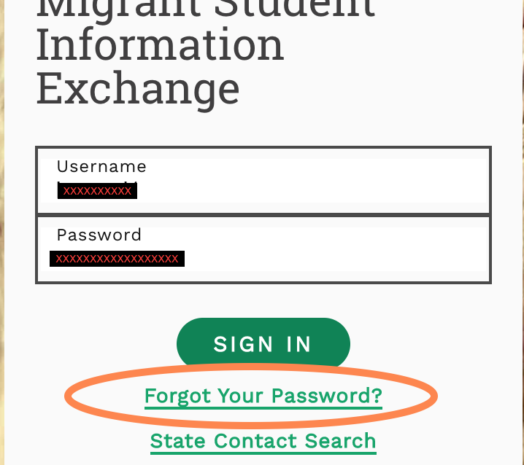
Passwords
are
case
sensitive
Notes:
This is a video… click again to start the video

Slide 6
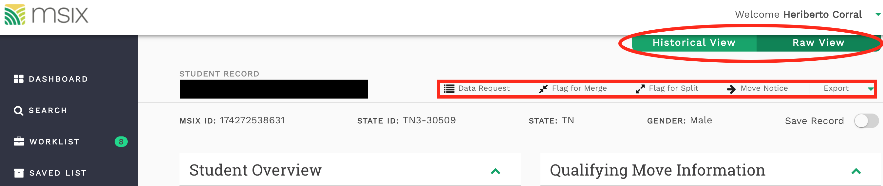
User Toolbar
Notes:
This is what will show up after you search for a student. This is the Consolidated View Screen. I have the other options for “view” circled in red. We will look at what historical view also looks like in a later slide. The student’s name is blacked out for privacy, but this is what you will initially see at the top: Student name, MSIX ID, state ID, and gender. In the red box, these are your user tools: (talk about each one briefly) data request, flag for merge, move notice, and export. – describe each one briefly

Slide 7

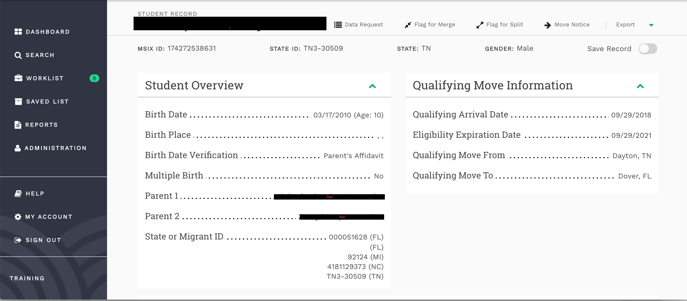
Student Overview: Consolidated View
Notes:
This is what else in in the top part of the consolidated view screen: explain the info that is shown– this is what is typically collected on the MEP COE

Slide 8

MSIX Users

Slide 9

Who can use MSIX?
MEP Staff (Recruiters, Liaisons, Advocates, Service Providers)
Counselors
Data Managers / Registrars
Notes:
We will talk about how each of these roles can utilize MSIX to their benefit

Slide 10
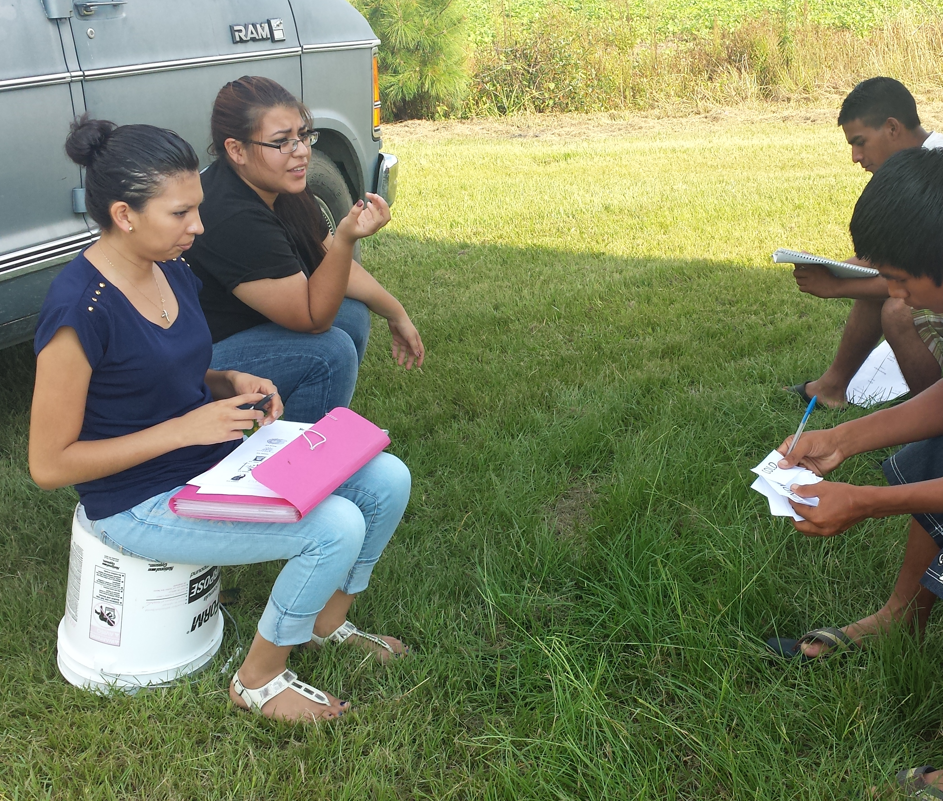
Using MSIX as a Recruiter
Send move notifications
Review past move information
Review family contact information

Slide 11

Using MSIX as a Counselor/Data Specialist
Send a move notification
View student’s immunization records
View special needs/circumstances markers
Obtain correct student demographic information
View student’s enrollment and course history
View student’s assessment history

Slide 12

Using MSIX as a Liaison/Migrant Advocate
Send move notifications
Research student record to determine any special needs
View student enrollment and assessment history to ensure appropriate grade and course placement
Use data to plan for MEP-specific services

Slide 13
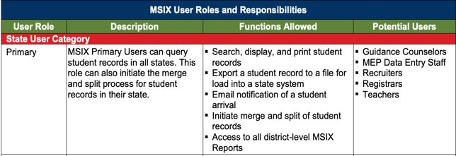
Primary User Administrator

Slide 14
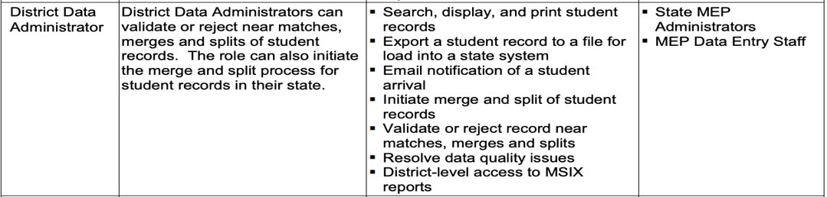
District Data Administrator User

Slide 15
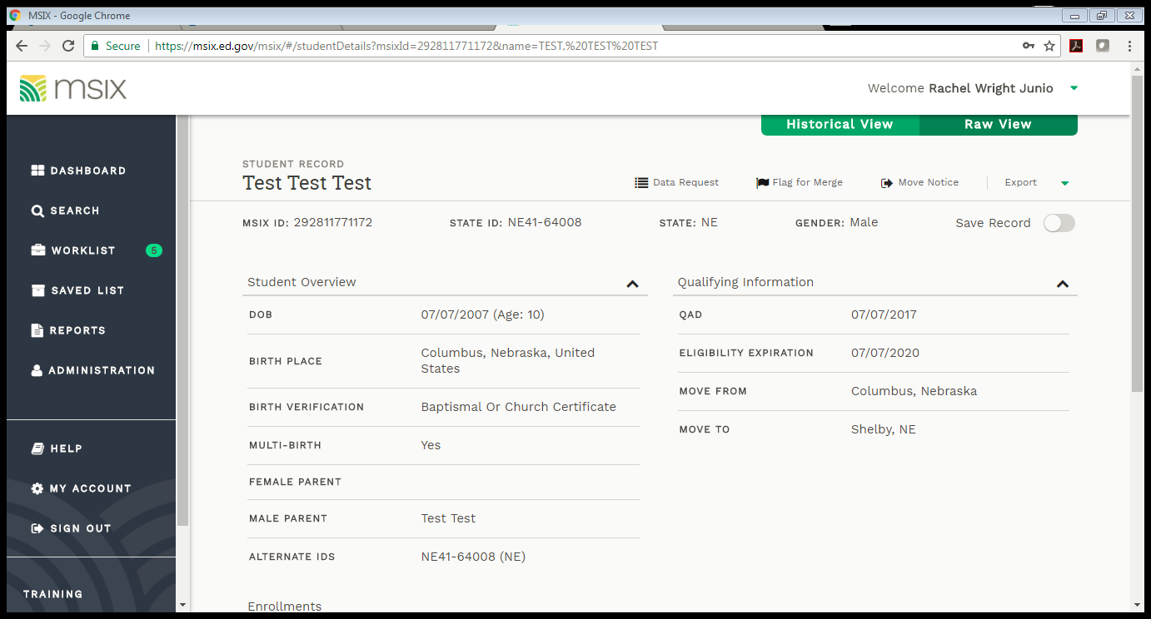
Data Request
States must respond to data requests within 10 working days
It is acceptable to send a data request when you notice errors or missing information on a student
34 CFR 200.85 (e)
Notes:
Demonstrate how to send a data request if you have not already.

Slide 16
User Toolbar
Notes:
This is what will show up after you search for a student. This is the Consolidated View Screen. I have the other options for “view” circled in red. We will look at what historical view also looks like in a later slide. The student’s name is blacked out for privacy, but this is what you will initially see at the top: Student name, MSIX ID, state ID, and gender. In the red box, these are your user tools: (talk about each one briefly) data request, flag for merge, move notice, and export. – describe each one briefly

Slide 17
Primary Users Reports

Slide 18

District Data Administrator Users Reports
(40% more)
Notes:
File submission: very technical report. This report displays the files submitted to MSIX from your State, along with the student count, record count, errors and rejections stemming from each data file
Data Validity: Also, technical report. This report provides the counts and percentages of records with Minimum Data Elements (MDEs) that are invalid in MSIX for your State (default view) and at the national level.
Data Completeness: This report displays the counts and percentages of missing Minimum Data Elements (MDEs) in MSIX for your State (default view) or at the national level
Run Reconciliation: Report done by NC Admin
Account List: DDAs do not have access to it.

Slide 19
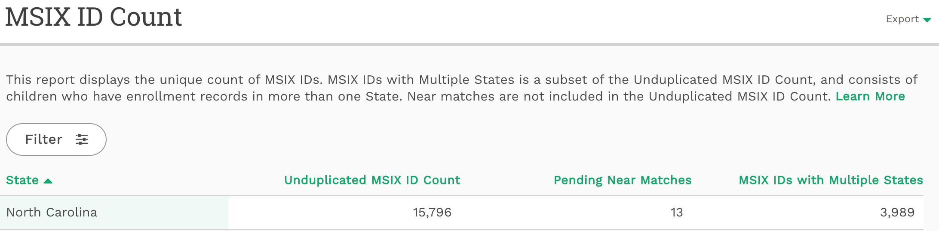
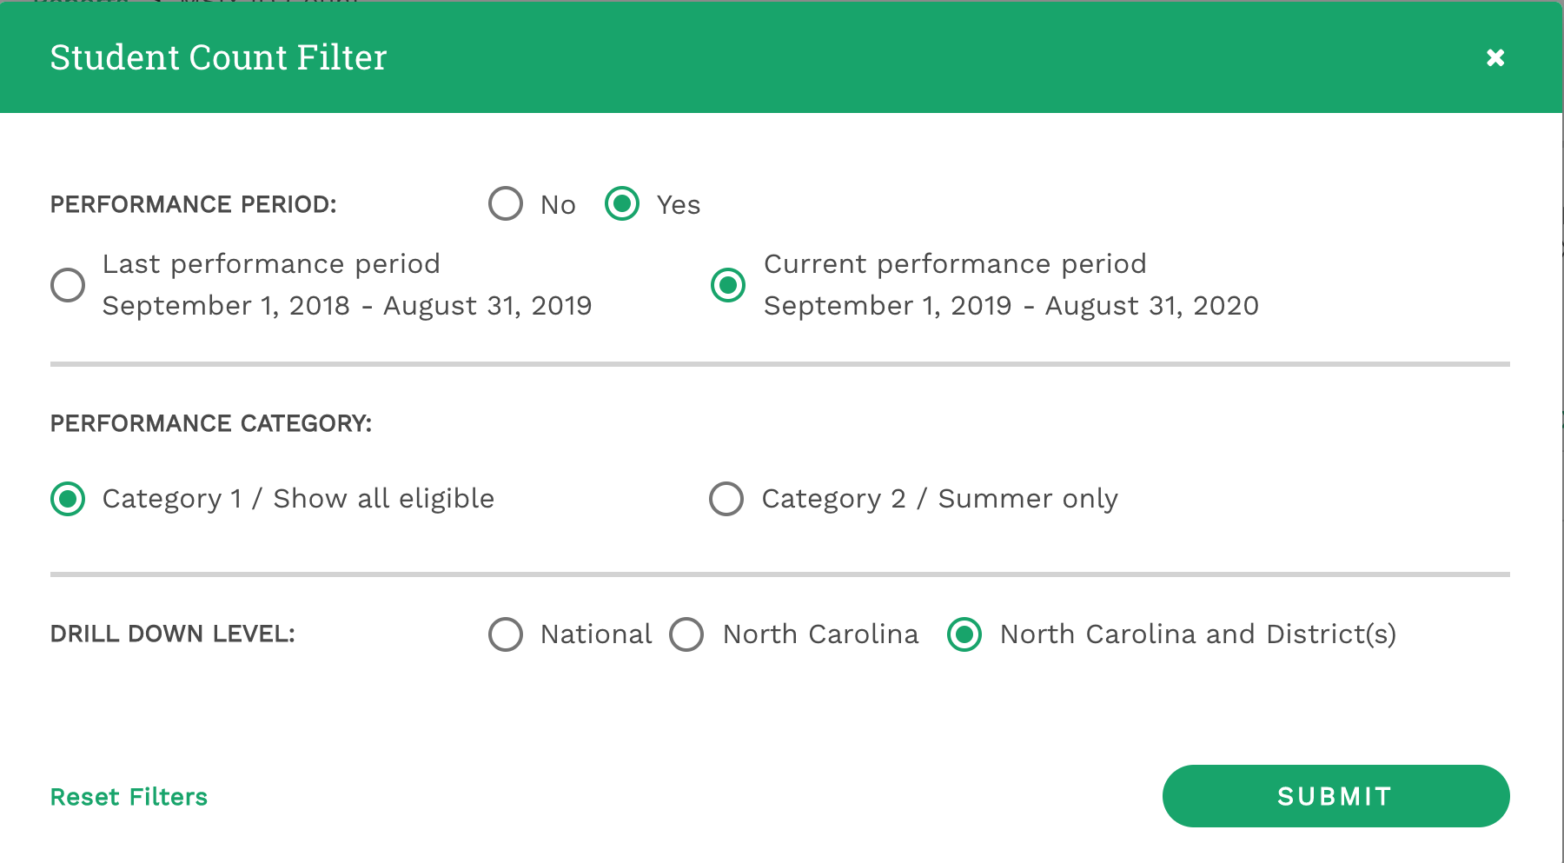
MSIX ID Count

Slide 20
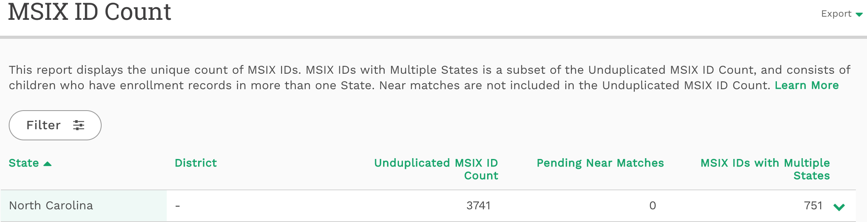
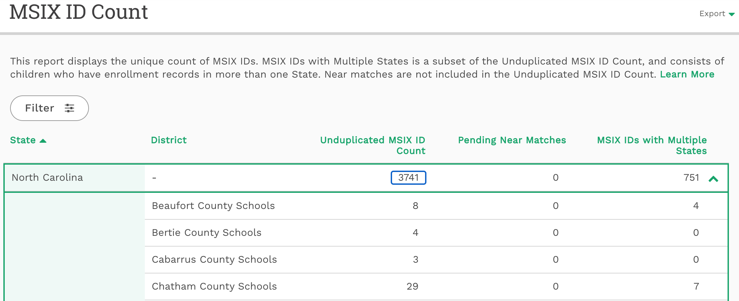
MSIX ID Count – CSV Download

Slide 21
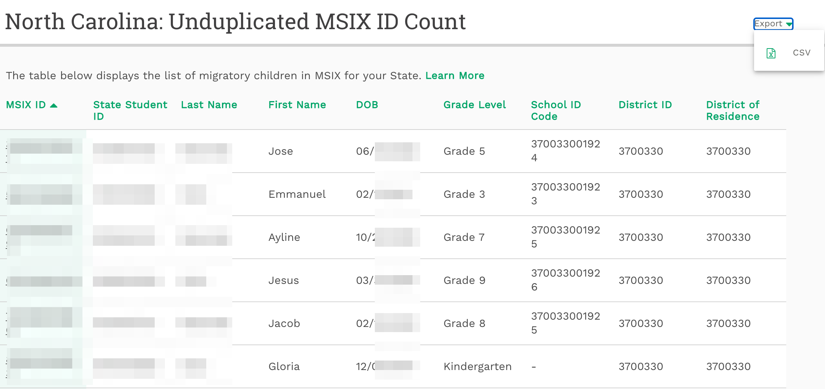
District MSIX ID Count

Slide 22
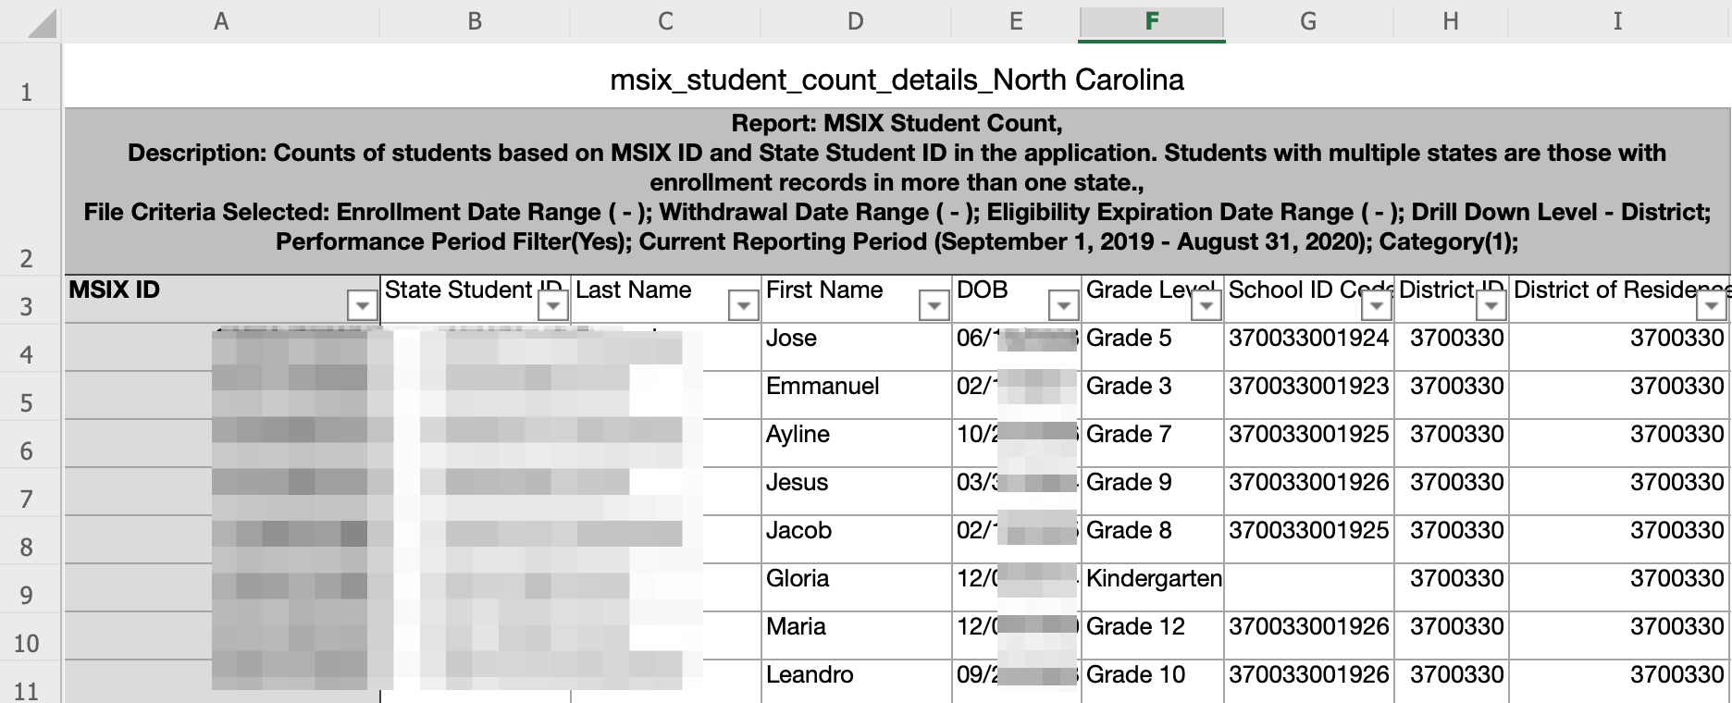
Open & Save it in Excel

Slide 23

District Data Administrator Users Reports
Notes:
File submission: very technical report. This report displays the files submitted to MSIX from your State, along with the student count, record count, errors and rejections stemming from each data file
Data Validity: Also, technical report. This report provides the counts and percentages of records with Minimum Data Elements (MDEs) that are invalid in MSIX for your State (default view) and at the national level.
Data Completeness: This report displays the counts and percentages of missing Minimum Data Elements (MDEs) in MSIX for your State (default view) or at the national level
Run Reconciliation: Report done by NC Admin
Account List: DDAs do not have access to it.

Slide 24
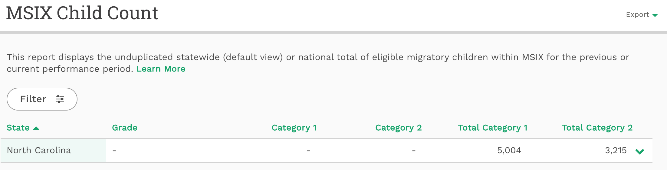
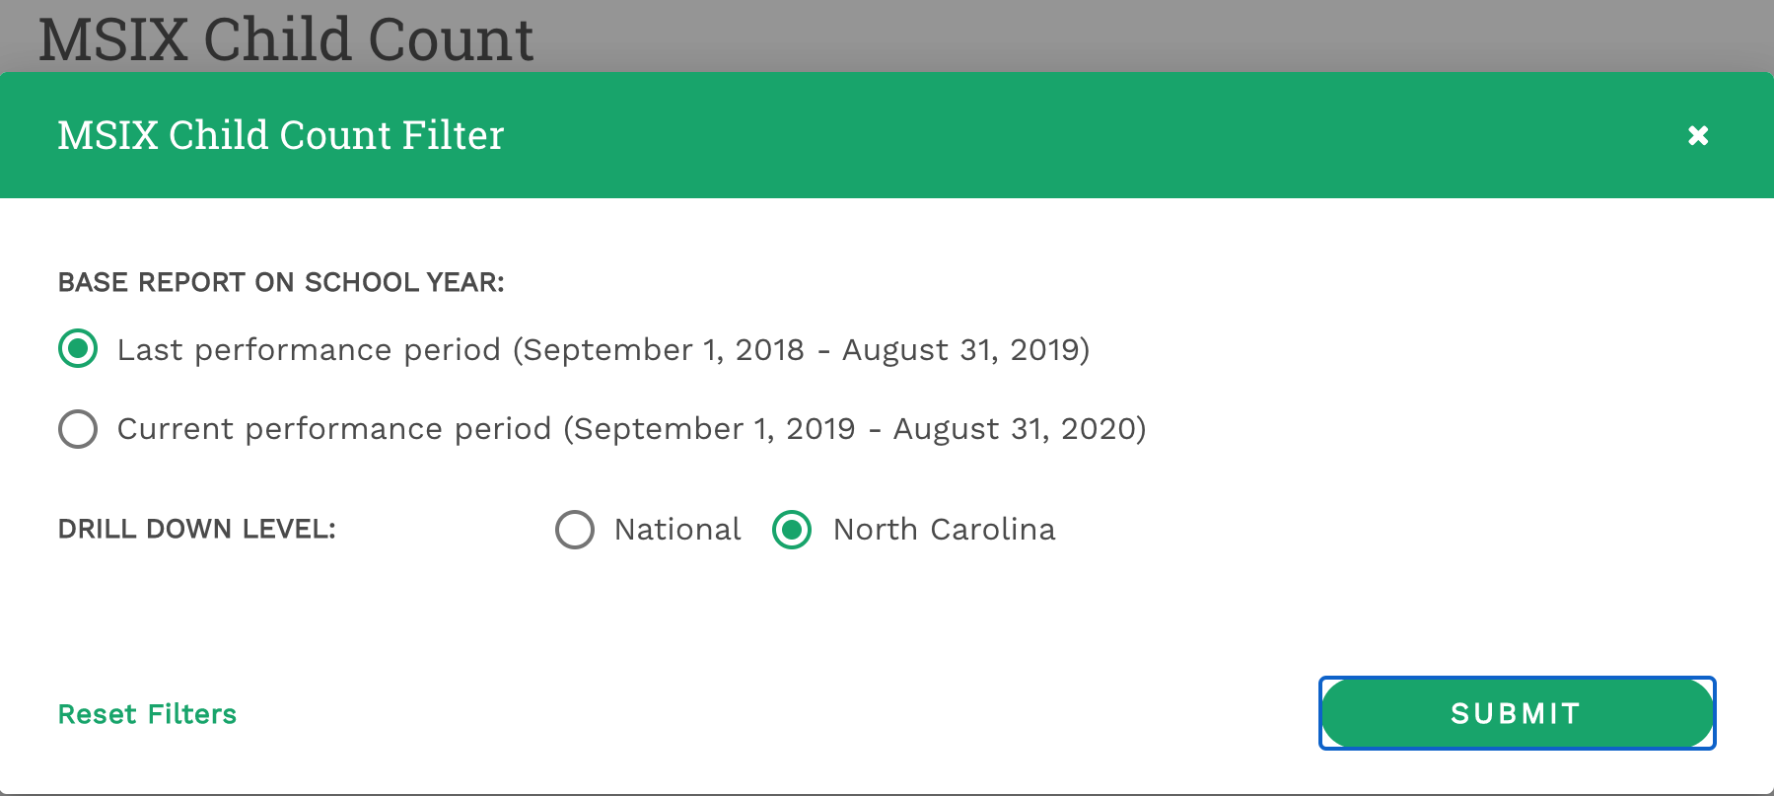
Child Count Report
Notes:
Child Count Report provides the unduplicated number of eligible MEP in the state. district ID is not accurate. This report is useful at the state level and not at the district level.

Slide 25
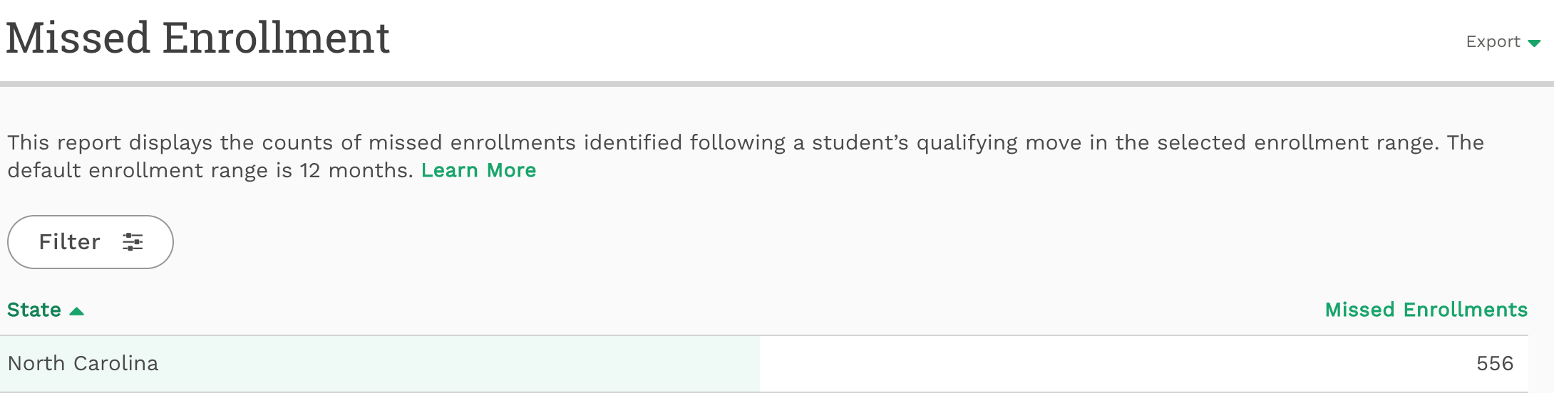
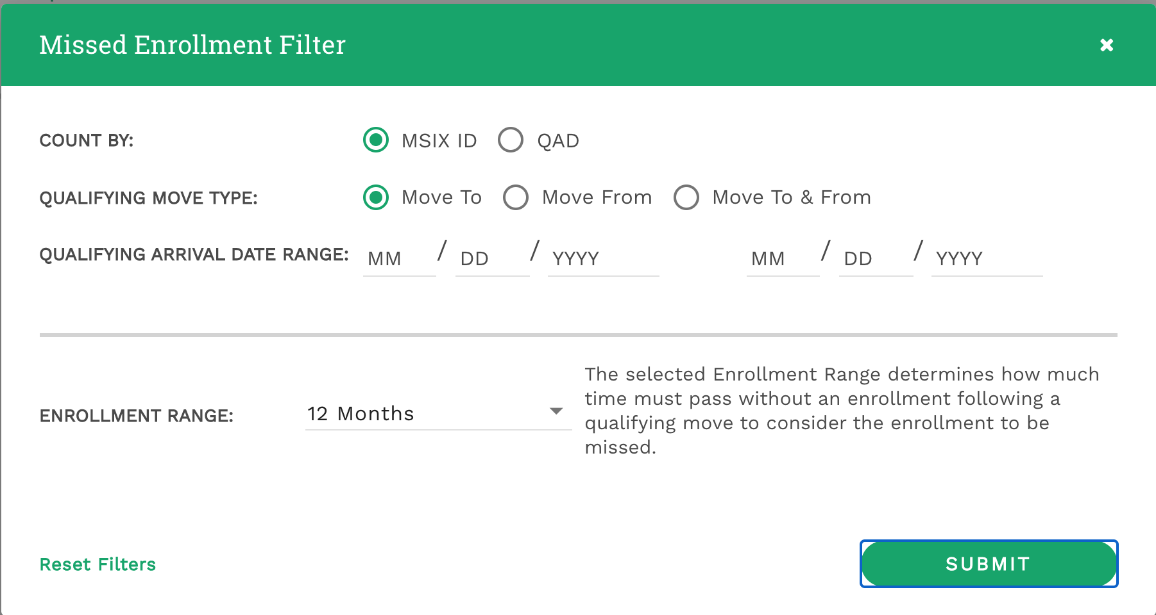

Slide 26
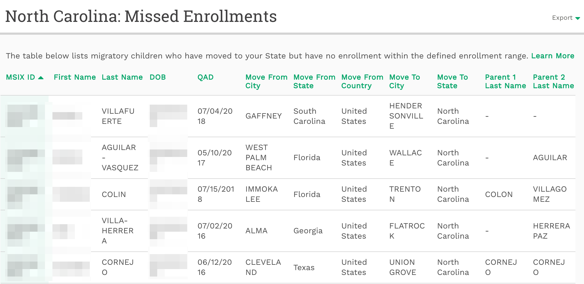

Slide 27
District Data Administrator Users Reports
Notes:
File submission: very technical report. This report displays the files submitted to MSIX from your State, along with the student count, record count, errors and rejections stemming from each data file
Data Validity: Also, technical report. This report provides the counts and percentages of records with Minimum Data Elements (MDEs) that are invalid in MSIX for your State (default view) and at the national level.
Data Completeness: This report displays the counts and percentages of missing Minimum Data Elements (MDEs) in MSIX for your State (default view) or at the national level
Run Reconciliation: Report done by NC Admin
Account List: DDAs do not have access to it.

Slide 28
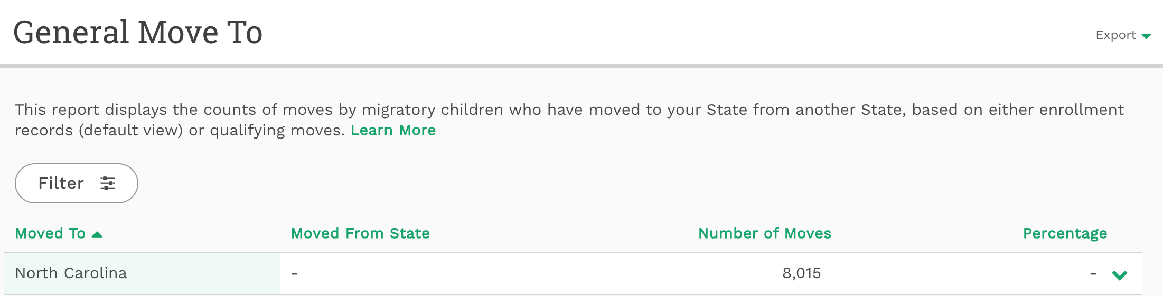
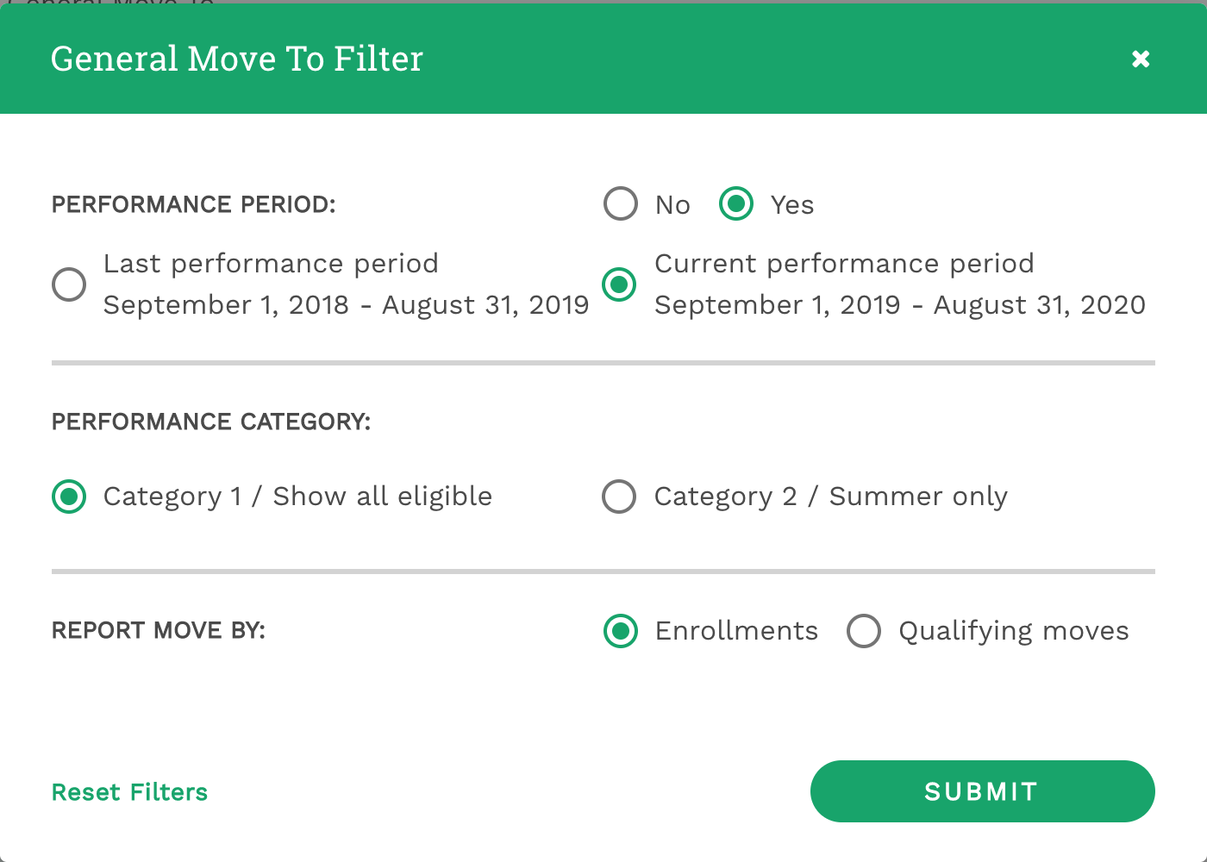

Slide 29
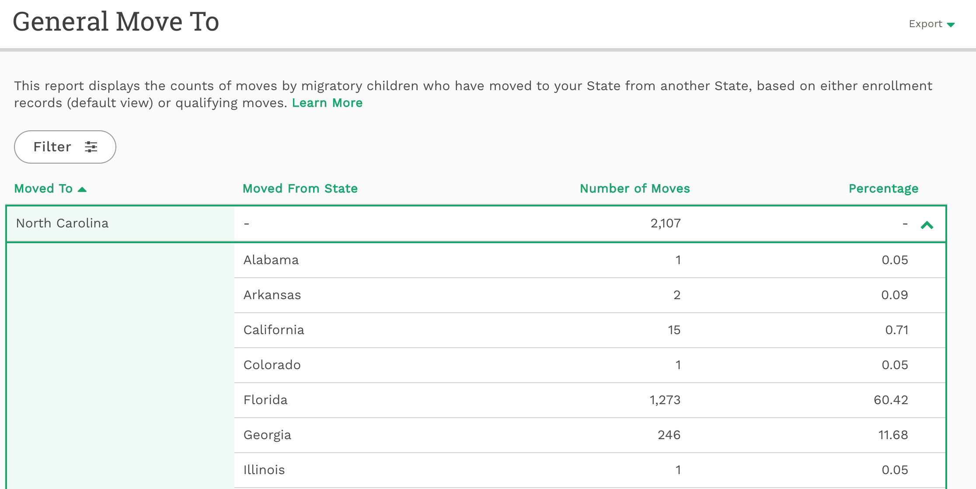

Slide 30
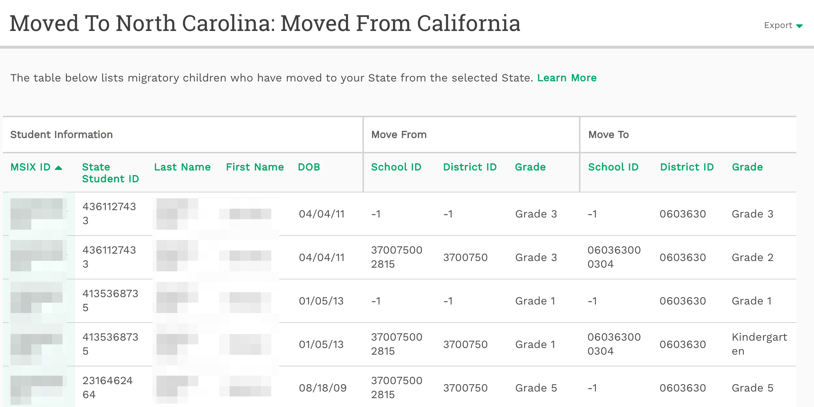

Slide 31
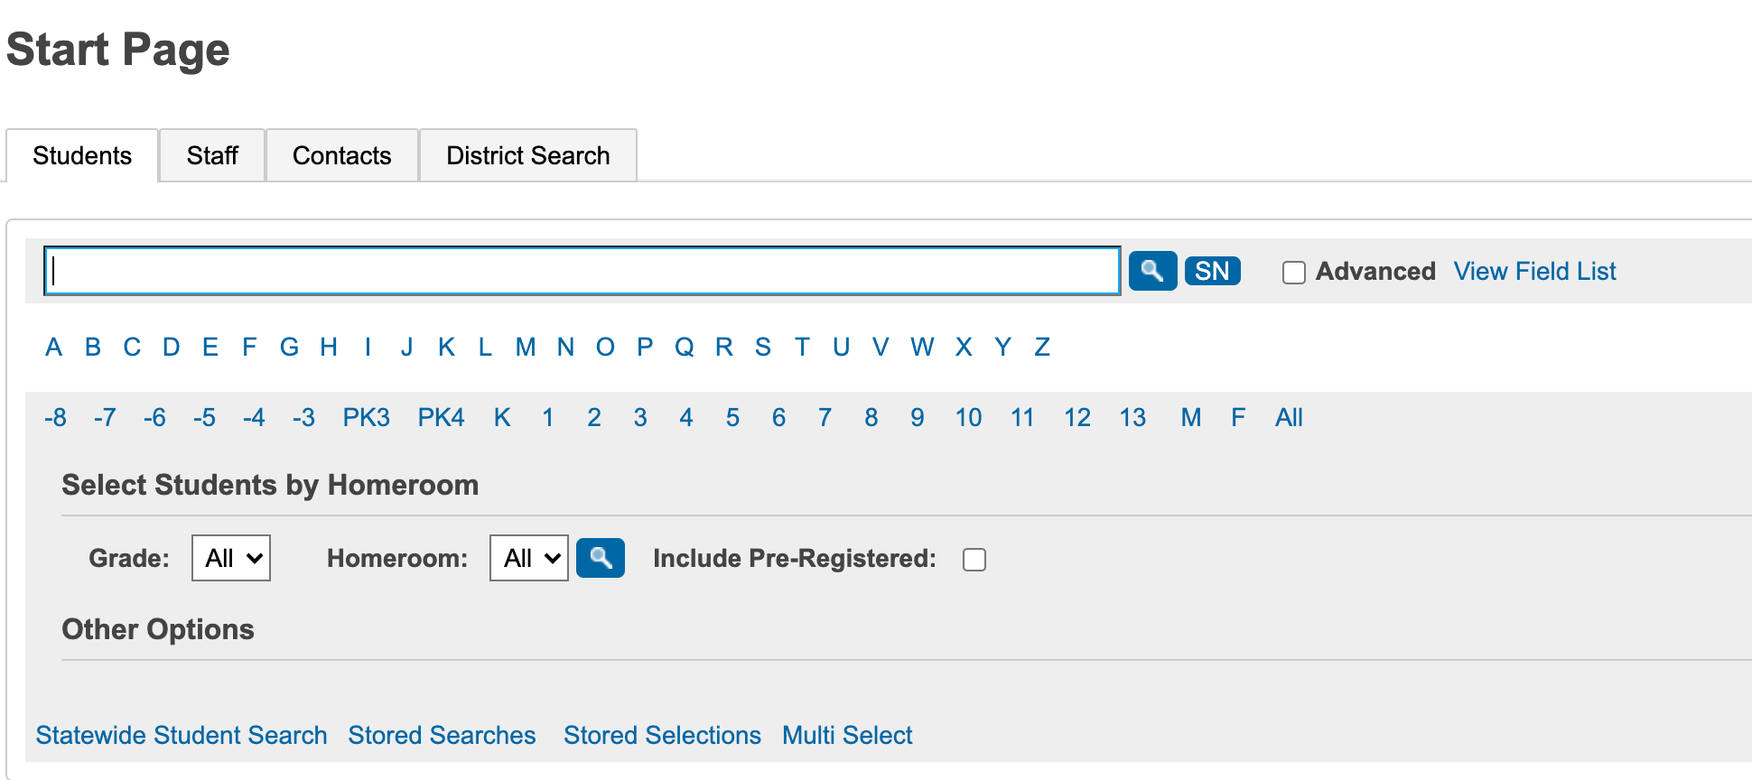
Using PowerSchool & MSIX

Slide 32
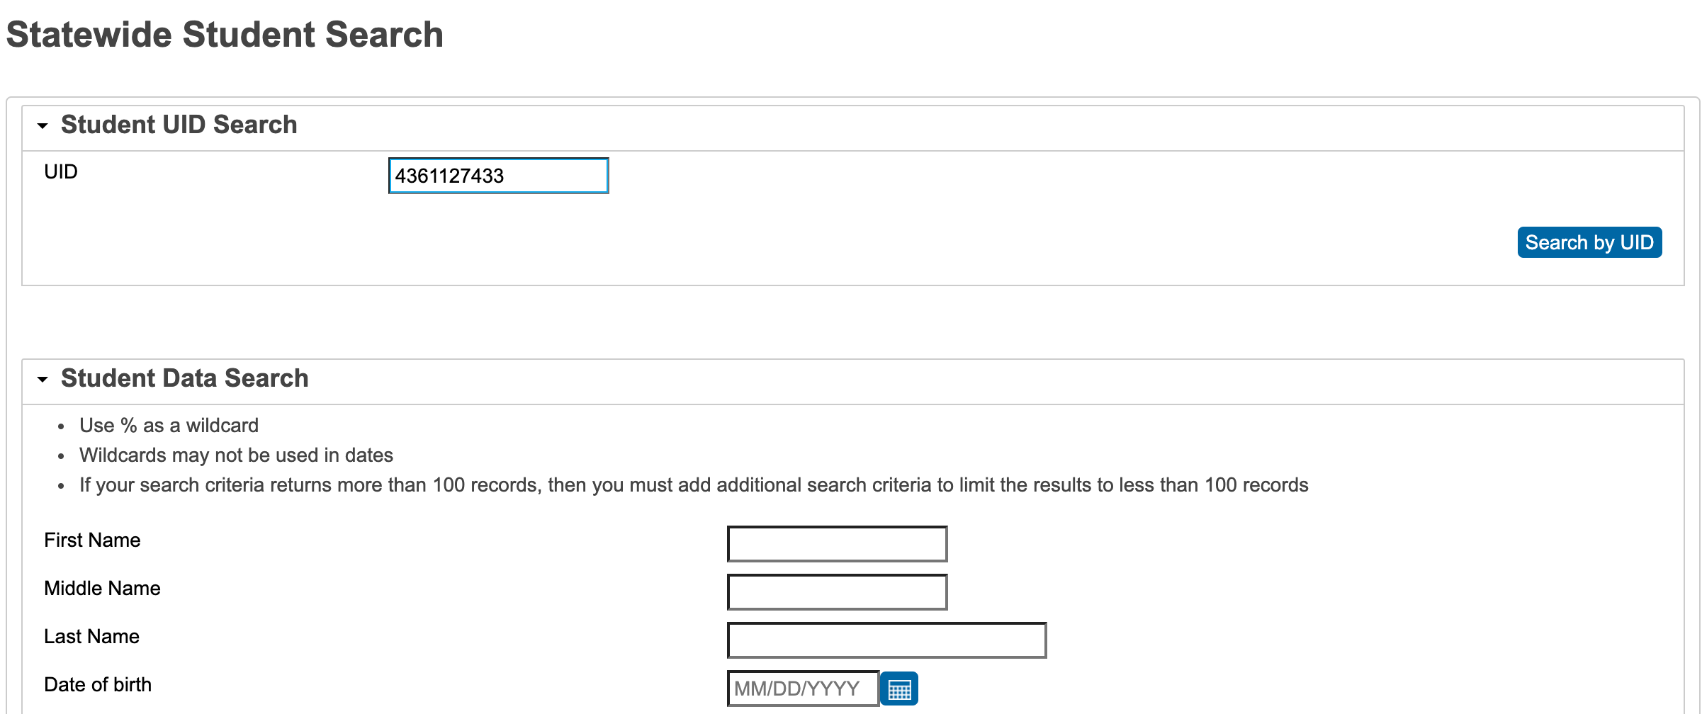

Slide 33

Summary
District Data Administrators have more tools and resources to identify and find possible migratory families
Most useful reports:
  MSIX ID Count
  Missed Enrollment
  General Move To
Interesting reports to review:
  Grade Retention
  Potential Duplicates
  Data Logic Issues
  General Move From

Slide 34

Summary - Cont
Use PowerSchool in combination with MSIX to find possible families
Run a monthly or bi-monthly New Enrollment Report in PS & conduct random searches from the report in MSIX for potential families
Become familiar with excel to work with data
Log in at least once a month
Remember…if you don’t use MSIX & PS to its fullest potential, you are missing great opportunities to find and identify potential families

Slide 35

Questions?
Heriberto Corral, Ed. D
NC MEP Administrator
heriberto.corral@dpi.nc.gov
984-236-2798

